Slide 1
Introduction to GitHub
SISMID Lab
July 22 through July 24, 2026
A Human – AI Teaming Approach to Infectious Disease Modeling

Slide 2
Lecture Overview
Topic | Slides
1. General Housekeeping | 2
2. Task Overviews | 4
3. Goal Output | 5
4. Roadmap | 6
5. Course Format Note | 7
6. GitHub Overview | 8–15
7. Activity: Forking GitHub | 16–22

Slide 3

General Housekeeping
Any slide with this icon contains the overview and
expected outputs for the included tasks. All outputs listed on these slides should be uploaded to the course GitHub repository for review.
Any slide with this icon indicates that it is time to complete a hands-on activity. Carefully follow the instructions provided, complete the required task, and verify your results.

Slide 4
Task Overviews
Activity | Description
Task 1: Forking GitHub | We will walk through how to fork the course repository on GitHub to create your own personal copy. You will create the fork, navigate to it, and open it so it’s ready to work in during the lab.

Slide 5
Goal Output
From the activity (see previous slide), you should get your own fork of the lab’s GitHub repository — a personal copy of the course repo hosted under your own GitHub account. By the end, your fork will be ready to open and work in during the lab.
Activity Output | Description
Your fork — github.com/your-username/course-repo | A personal copy of the lab’s GitHub repository saved under your own GitHub account, which you fully control — browse files, make changes, and open pull requests throughout the lab.

Slide 6
A quick note before we dive in: This is an AI course — not an intro to GitHub. The tools we'll touch on are just that: tools, meant to support the real work, which is your modeling. We'll give you enough to feel confident and keep moving. And if you hit a snag along the way, don't worry — this is just a small piece of the picture, not the focus. If something sparks your curiosity or you want to go further, our door is always open.

Slide 7
GitHub Overview

Slide 8




What Is GitHub?
GitHub is a platform for storing, sharing, and collaborating on code and files. Think of it as a shared folder in the cloud — but with version history, quality checks, and structure.
Repository
Fork
A collection of folders on GitHub. Our class has one shared repository, made up of many folders.
Your own copy of the class repository on your GitHub account. You work here freely without affecting the original.
Push
Pull Request
How you will upload your local changes from VS Code to GitHub. We will walk through this together in Activity 0.
A request to merge your work into the main repository. This is where the agent checks your work.

Slide 9

Key Tabs You'll Use
You don't need to know everything on GitHub — just these three tabs.
Code
Browse all files in the repository. This is the home page. You'll see the shared data folder and all student folders here. Click into folders to see their contents.
Pull
Requests
Where your submissions live. When you push your work and open a pull request, it shows up here. You can see the agent's feedback, check if your submission passed, and track your progress.
Actions
Where the automated agent runs. You can click into a run to see exactly what the agent checked and why it passed or failed. Useful for debugging.

Slide 10
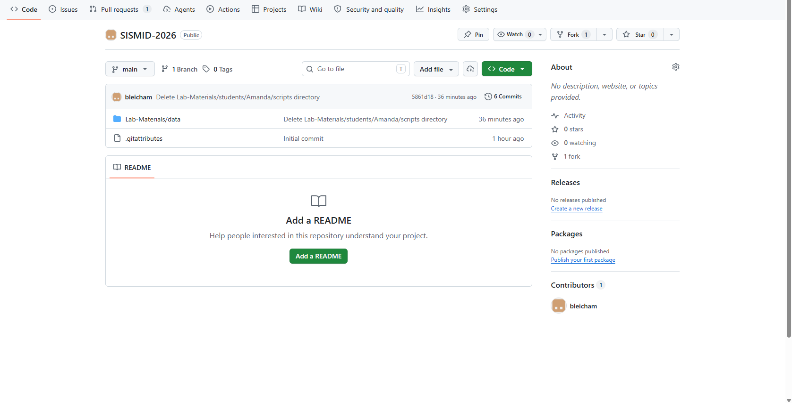
Our Course’s Repository
Notes:
Will replace with official

Slide 11
Code Tab
The Code tab contains the repository’s files and folders, branch selector, commit history, and README file. Think of it as the main folder directory for the project.
Lab-Materials Folder
We will be working out of the Lab-Materials folder for our lab. The additional folders are for our website and additional lecture materials.
Notes:
Will need to update image one github is complete

Slide 12
Pull Requests Tab
A pull request (PR) is a proposed change to the main repository. The Pull Requests tab is where contributors submit changes, discuss updates, review code, and merge approved changes into the project. We will walk through how to create a pull request later in the lab.
Notes:
Will need to update image one github is complete

Slide 13
Actions Tab
The Actions tab is the central dashboard for monitoring, managing, and manually running automated workflows within a repository. In this lab, it is where you can view the status of agent-driven submission checks, monitor workflow progress, and identify any errors or successful submission notifications.
Notes:
Will need to update image one github is complete

Slide 14

Lab Workflow: How will we use GitHub?
Work Locally (Fork)
Push to GitHub
Agent checks
Merge
Edit rules, generate code,
run scripts in VS Code.
Upload your changes
to be checked.
Automated checks run
on your submission.
If checks pass, your
work merges to your folder in the main repository.
You will repeat this cycle for each phase of the lab. Push early and often — the agent gives you feedback each time and helps you keep record of all your changes.
Notes:
NPT EXPECTED TO FOLLOW

Slide 15
Activity: Forking GitHub

Slide 16
What Is a Fork?
A fork is your own complete copy of a repository on your GitHub account.
You can freely edit your fork without affecting the original.
When you're ready, you submit a pull request to merge your changes back.

Slide 17
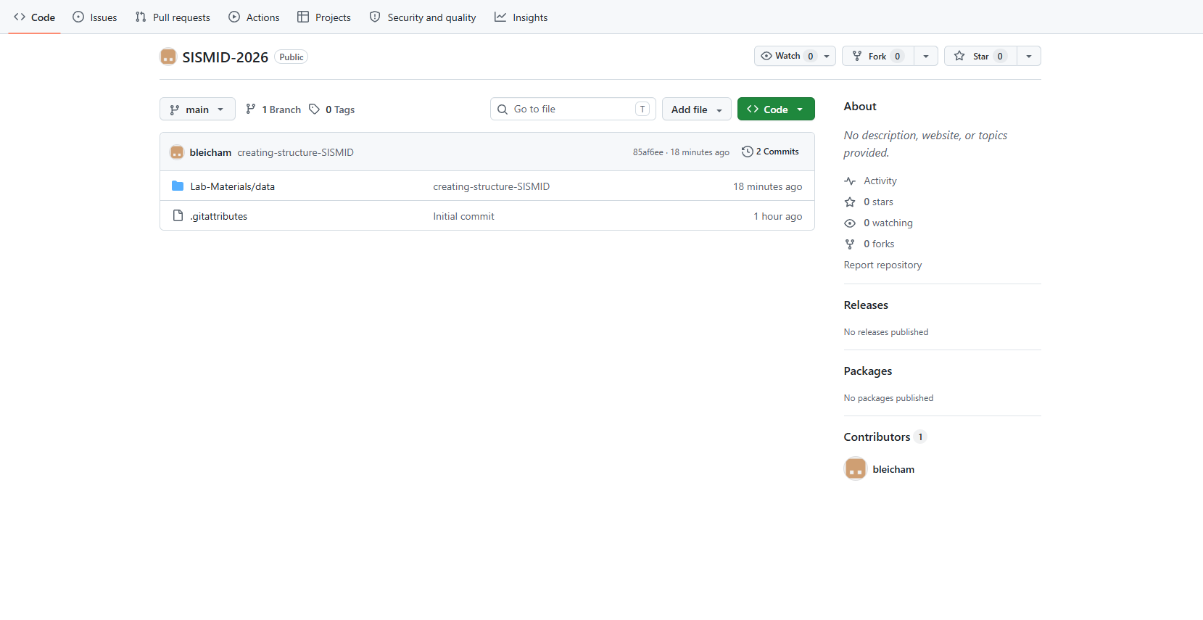
Starting with the Course Repository
Step 1: Clicking ‘Fork’
To start the process of creating your ‘Fork’ of our GitHub repository, click the ‘Fork’ button in the upper right corner of the repository.
Notes:
Add header to slides/transitions to slides

Slide 18
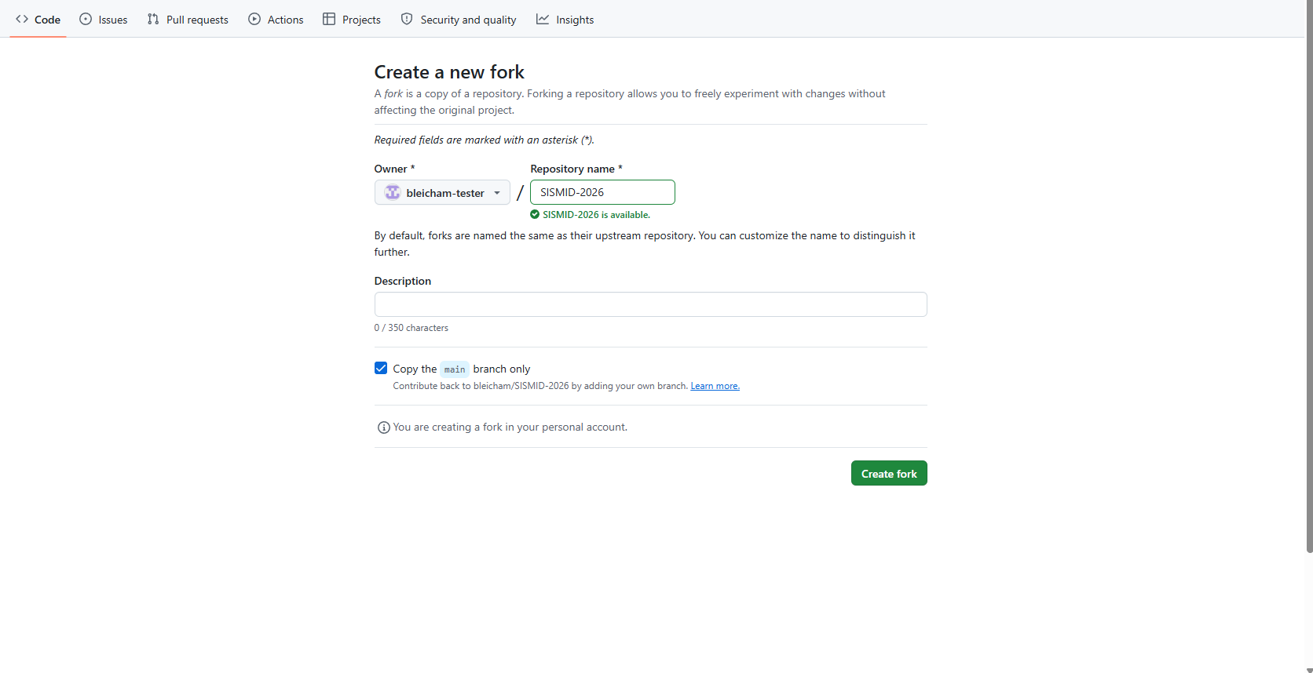
Step 2: Creating a New Fork
Prior to clicking the ‘Create fork’ button, you can set some customizations such as the name of the repository. You will also want to double check that the correct `owner` is selected.
Once you are ready to copy the repository over to your account, click the ‘Create fork’ button.

Slide 19
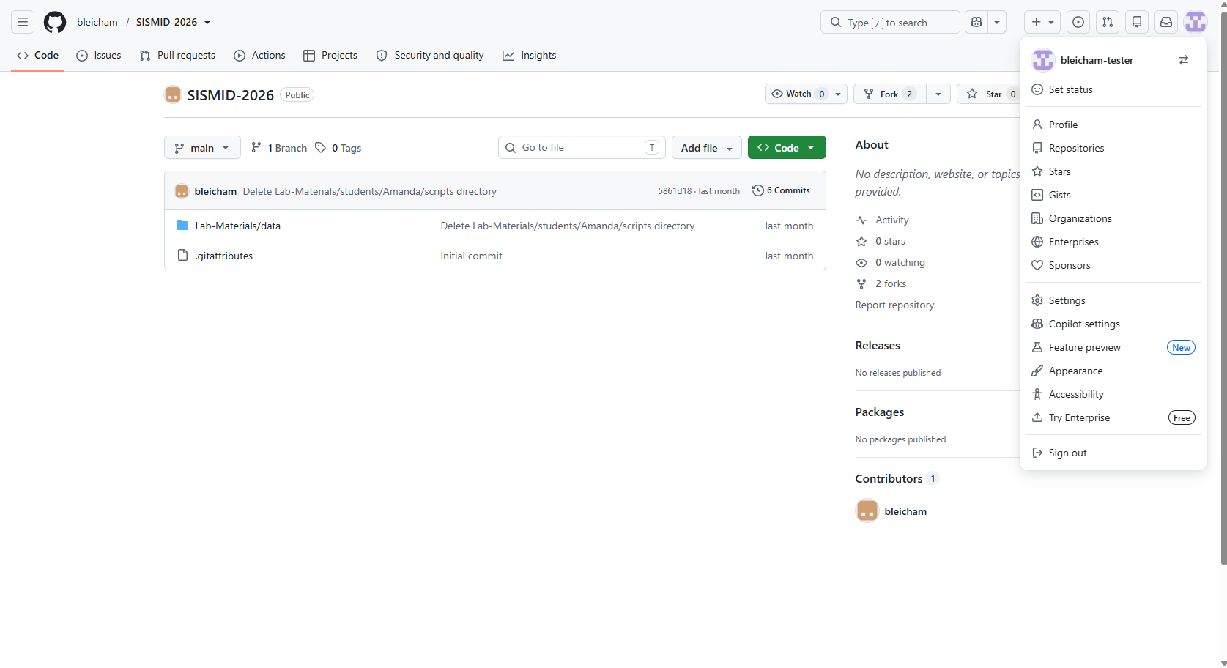
Navigating to our Fork
Step 1: Navigating to our Fork
Now that we have created our fork, or copy, of the course repository, we need to navigate to it within the list of our own repositories.
First, click on your GitHub icon in the upper right-hand corner. Next, click the Repositories menu option. This will open the list of all repositories that you own under this GitHub account.

Slide 20
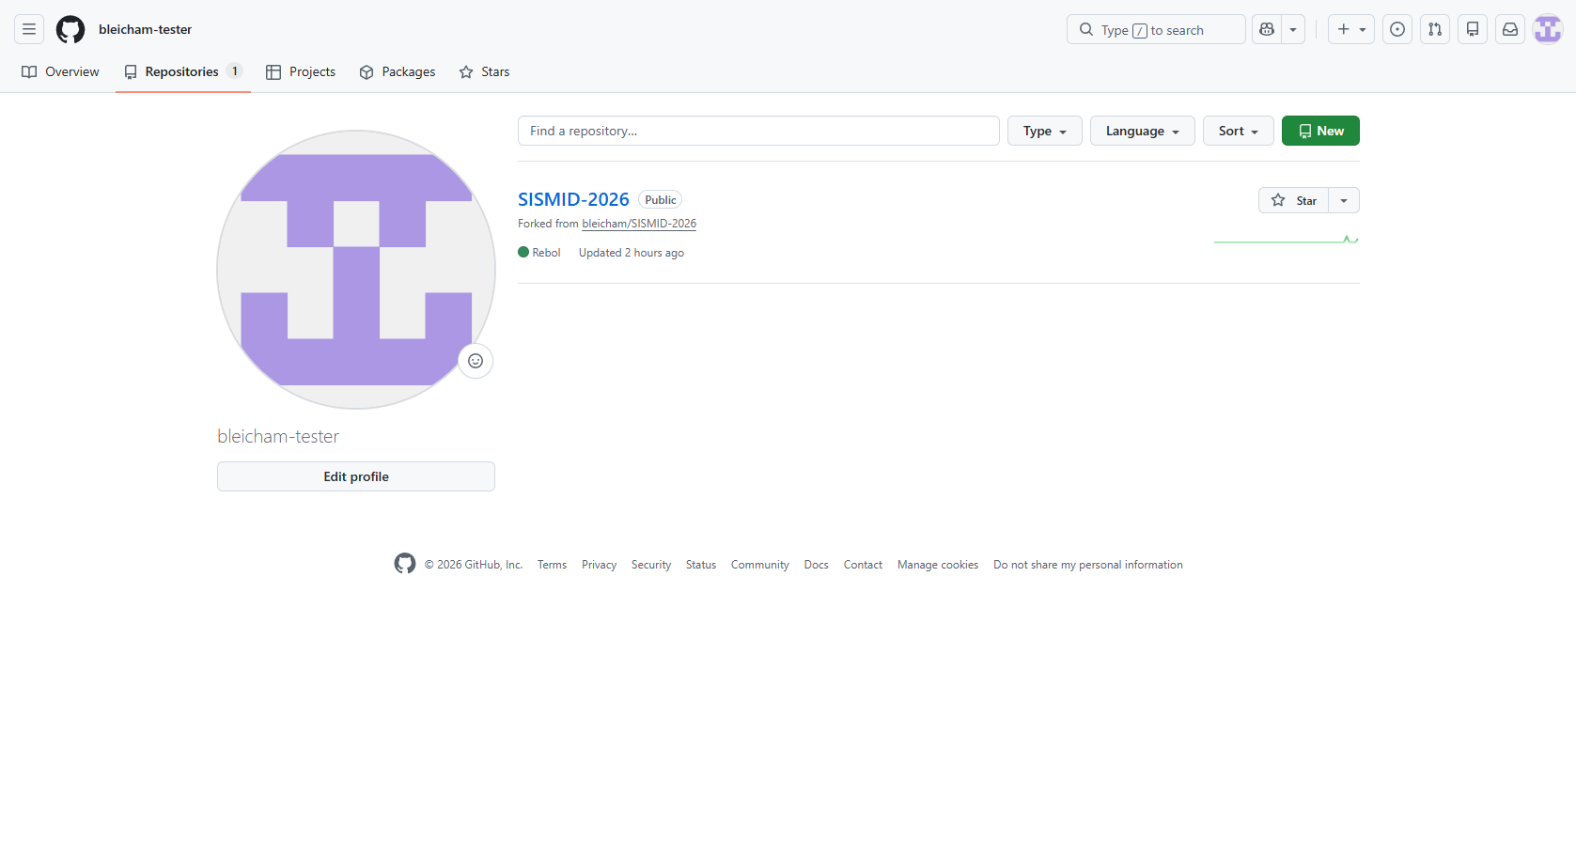
Step 2: Opening the Fork
Now that we have navigated over to our own GitHub repositories page, we need to open the fork. To do so, click the title of the repository (Blue title).

Slide 21
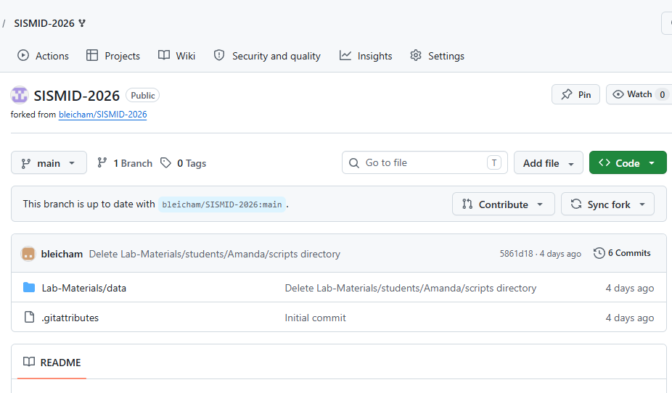
You should now see your fork (personal copy) of the course GitHub repository in your own GitHub account.
At the top of the page, you should see a message indicating that your branch is up to date with the original repository, along with Contribute and Sync fork buttons. We will discuss different ways to contribute changes back to the original repository later in the lab.
The Sync fork button allows you to pull in updates from the original repository, ensuring that your fork remains current with the latest changes.

Slide 22
Exploring the Directory Structure

Slide 23
Overview: Lab Directory Structure
The lab directory is your organized workspace for every hands-on activity in this course.
A standardized, consistent structure
Keeps everyone's code consistent and easy to navigate
Each lab activity has its own dedicated folder within the main directory folder (we will cover this on the next slide).
AI-assisted workflow
You'll partner with AI throughout to maintain clean, well-structured output as part of the rules document.

Slide 24
Current GitHub + Lab Directory Structure

Slide 25
Where are we going?

